Slide 1
Falmouth Housing Production Plan
Community Housing Forum II
October 16, 2018

Slide 2
Purposes
Obtain updated information on demographic, economic and housing characteristics and trends;
Better understand the current housing market dynamic;
Document priority housing needs;
Identify strategies to address identified needs and goals;
Provide guidance to strategically invest local resources, and
Create a roadmap for getting closer to the state’s 10% affordability goal.

Slide 3
What are Housing Production Plans?
State regulations under Chapter 40B offer communities greater local control over affordable housing development.
First step is getting Housing Plan approval from the state. The Housing Needs Assessment is the 1st major component of such Plans.
Plan must also include annual affordable housing production goals (74 units/year for Falmouth based on 0.5% of year-round housing units) and strategies to address identified local needs and meet these goals.
For each one-year or two-year goal met, the Town can apply for and receive state certification with a 1- or 2-year period during which the ZBA can deny 40B projects without the developer’s ability to appeal if they are determined to be inappropriate or not responsive to local needs.
Falmouth received such certification based on its 2009 Housing Production Plan.

Slide 4
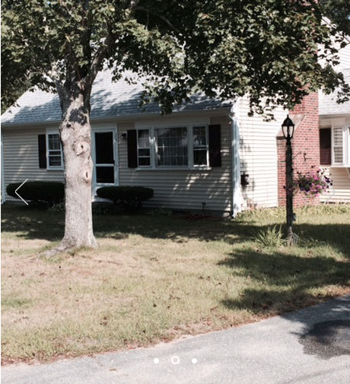
What is affordable housing?
Permanent units subsidized or approved by a subsidizing agency
Deed restricted
Affirmatively marketed but 70% can be reserved for local preference.
Available to households earning at or below 80% of area median income (AMI)
Photo: FHA Family Scattered-site Homes

Slide 5
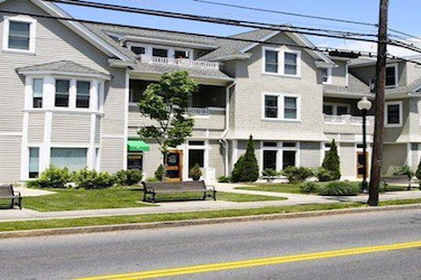
What housing is “affordable” in Falmouth?
Of the 14,870 year-round housing units, 959 or 6.45% are currently considered affordable by the state.
Another 305 units should be eligible for inclusion in the SHI units increasing the affordability percentage to 8.5%.
The number of affordable units needed will increase over time based on housing growth.
Photo: FHC 704 Main Street

Slide 6
Priority Housing Needs: Rentals are Top Priority
Rental units are top need to offer more affordable housing choices/Goal of 85% of units produced
Need permanent, year-round housing for most vulnerable residents and workforce.
Help diversify the housing stock as 86% of units are single-family detached dwellings.
Provide greater opportunities to build at some larger scale and leverage other sources of financing as almost all state and federal housing subsidies are for rental development.
Help meet 10% and annual housing production goals faster as all rental units in a 40B development count as SHI units.
Provide more appropriately sized units for increasing numbers of smaller households.
Offer opportunities for mixed-income housing with several income tiers including those earning at very low income levels who have the greatest cost burdens.
Benefit greater numbers of households as rentals turnover more regularly than ownership units.

Slide 7
Priority Housing Needs: Homeowner- ship is the next priority
Homeownership is needed to attract and retain workforce and families/Goal of 15% of units produced
Offers smaller-scale development and infill housing opportunities, typically financed almost exclusively with local funding.
Provide first-time homeownership for families who are shut out of the housing market and would otherwise be unable to afford to live in Falmouth.
Provide more housing options for empty nesters looking to downsize.
Lend additional stability to neighborhoods as owners tend to become more rooted and invested in the community.

Slide 8
Priority Housing Needs: People with disabilities or special needs
Integrate handicapped accessibility and/or supportive services into new development/Goal of at least 20% of all units created for seniors or single individuals and 10% for family housing
14.2% of residents claimed a disability, higher than the state at 11.6%.
Needs will increase with aging of the population.
Limited handicapped accessible units in existing subsidized housing.

Slide 9
Challenges to Producing Affordable Housing in Falmouth
Infrastructure
80% sewer capacity limit, denitrification requirements and Flow Neutral Bylaw are significant development constraints
Zoning
Measures to better promote affordable housing and smart growth have largely been ineffective
Environmental concerns
Complex and sensitive mix of environmental characteristics
Property costs and availability
More limited land available for development
High costs of land and homes
Availability of subsidy funds
Community perceptions
NIMBY
Local political will
Limited public transportation

Slide 10
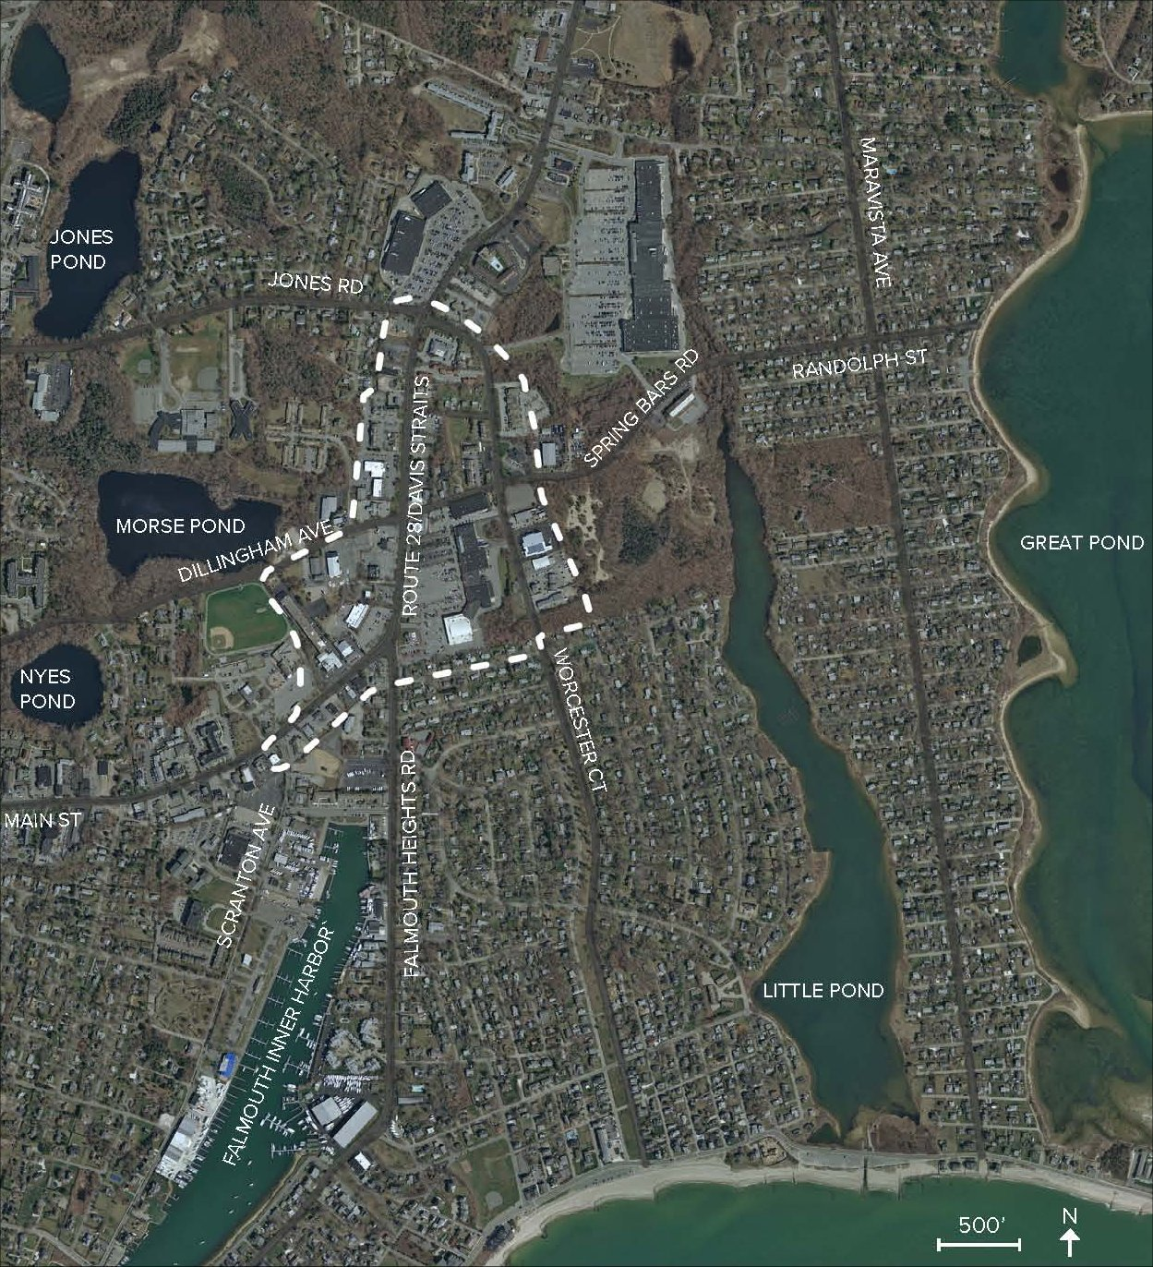
Housing Strategies
Sources include:
Previous Plans and Studies
The Community Housing Workshop held on July 12, 2018
Stakeholder interviews
AHC and Housing Coordinator input
Production goals
Effective strategies from other comparable communities
Housing Needs Assessment including targeted housing needs and goals
Photo: Davis Straits Study Area

Slide 11
Capacity Building Strategies
Conduct ongoing community outreach and education
Provide additional support for the FAHF
Consider Municipal Affordable Housing Trust Fund model
Secure additional resources to capitalize the Fund
Formalize the monitoring of SHI units
Create an affordable housing database
Enforce requirements
Consider introducing annual monitoring fees
Ensure eligible units are included on the SHI
Preserve expiring use units
Consider establishing a regional monitoring entity
Hold mortgages on affordable units
Conduct additional research and planning
Prepare a land use growth map
Conduct a demographic study of mobility patterns

Slide 12
Zoning and Regulatory Strategies
Modify ADU bylaw
Finalize and adopt draft being reviewed by the ADU Working Group
Encourage multi-family and mixed-use development
Adopt Chapter 40R Smart Growth Overlay zoning
Allow residential uses in the Falmouth Mall area
Create Village Center zoning
Use the “friendly 40B” process
Allow more diverse housing types in more areas
Missing middle concept – integrating more types of housing in existing neighborhoods
Expand inclusionary zoning
Adopt a Town-wide bylaw to capture affordable units in new development
Explore tax relief for year-round rentals
Consider adopting Provincetown and Wellfleet models

Slide 13
Production Strategies
Make suitable public property available for affordable housing
Review of sites from 2009 HPP
Potential additional properties
Further site acquisition
Use of new state resources
Promote partnerships with developers
Existing zoning and proposed changes
“Friendly 40B” process
Financing
Advocacy
Other incentives (expedited permitting, fee waivers, density bonuses, allocating sewer capacity, tax subsidies)
Encourage special needs housing
Support financing and help market and fill vacancies
Explore regional partnerships

Slide 14
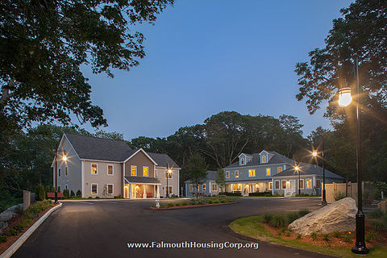
Next Steps
Finalize Plan
Obtain Planning Board and Board of Selectmen approval
Submit Plan to DHCD for state approval
Photo: FHC Notantico Woods Development

Slide 15
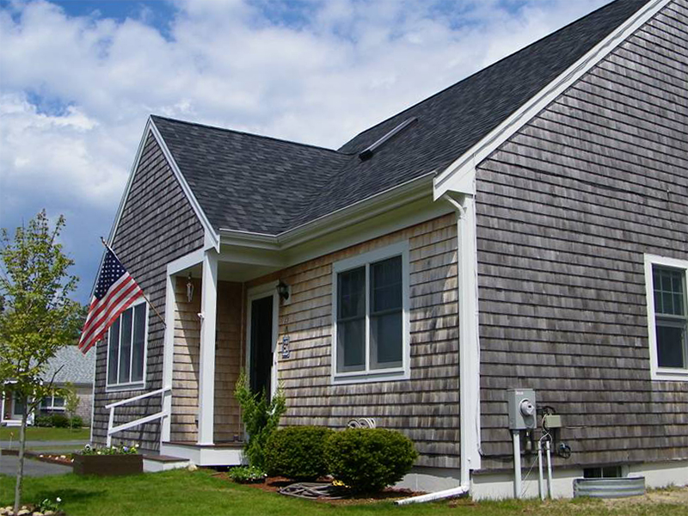
For more information….
Go to the Town’s website at www.falmouthmass.us/396/Affordable-Housing-Committee to review the draft Housing Needs Assessment and other affordable housing materials.
Photo: FHT East Ridge Road

