Slide 1
CLEAN WATER ACT (1972)
EPA DESIGNATED TO ASSURE COMPLIANCE WITH THE ACT
NATIONAL POLLUTANT DISCHARGE ELIMINATION SYSTEM (NPDES)
MS4 GENERAL PERMIT ADMINISTERED JOINTLY BY EPA AND MASSACHUSETTS DEP

Slide 2
MUNICIPAL SEPARATE STORM SEWER SYSTEM
MS4 PERMIT
EFFECTIVE DATE JULY 1, 2018

Slide 3
NOTICE OF INTENT (NOI)
FILED SEPTEMBER 26, 2018
NOI PLANS FOR COMPLIANCE WITH 6 MCMs
PREPARE STORMWATER MANAGEMENT PLAN WITHIN 1 YEAR FOR MCM COMPLIANCE

Slide 4
MINIMUM CONTROL MEASURES (MCMs)
MCM 1: PUBLIC EDUCATION AND OUTREACH
MCM 2: PUBLIC INVOLVEMENT
MCM3: ILLICIT DISCHARGE DETECTION AND ELIMINATION (IDDE)
MCM 4: CONSTRUCTION SITE STORMWATER RUNOFF CONTROL
MCM 5: POST CONSTRUCTION MANAGEMENT
MCM 6: MUNICIPAL GOOD HOUSEKEEPING

Slide 5
RECENT EXAMPLE OF SOME TYPICAL REQUIREMENTS
WHITE’S LANDING
EAST FALMOUTH

Slide 6
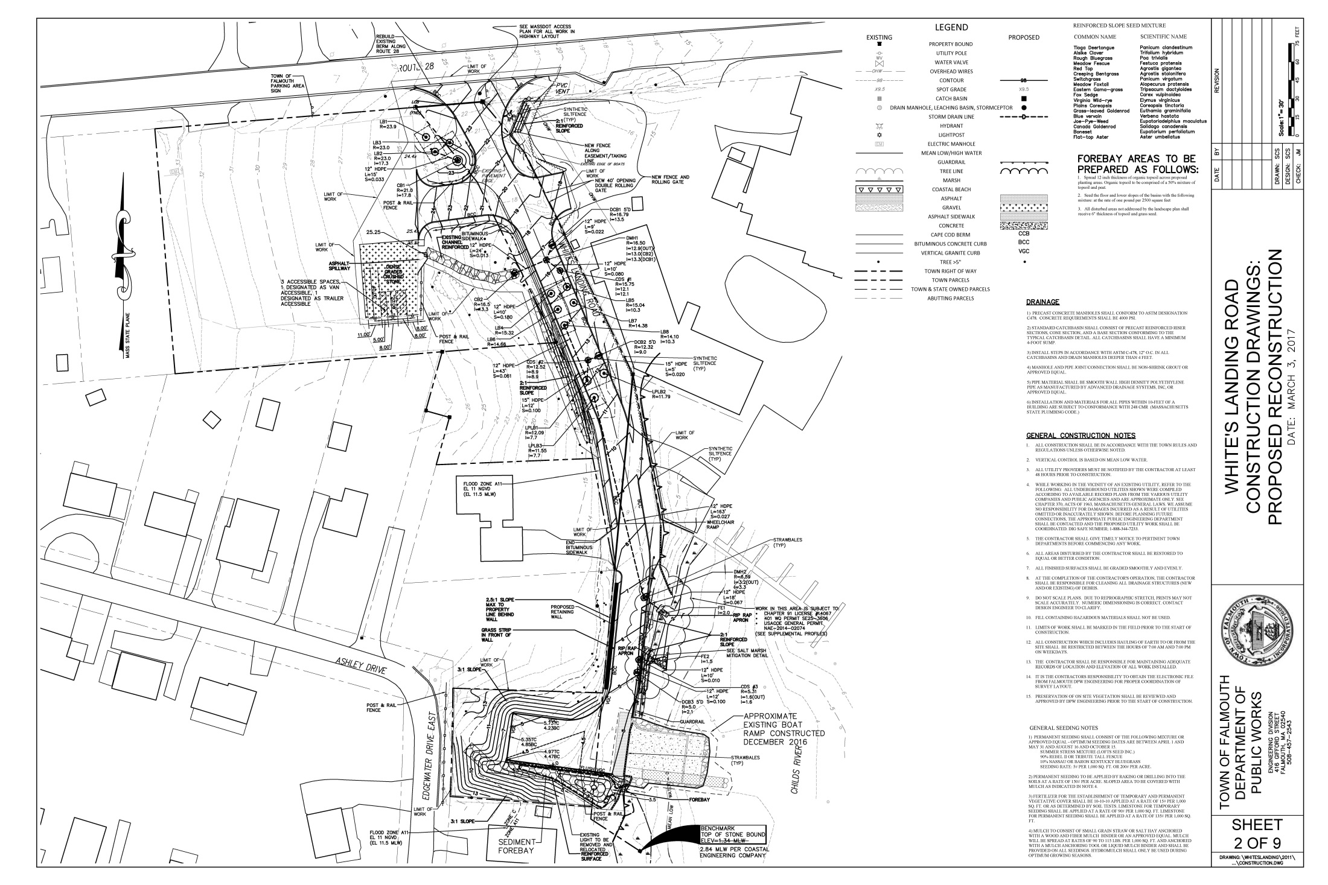

Slide 7
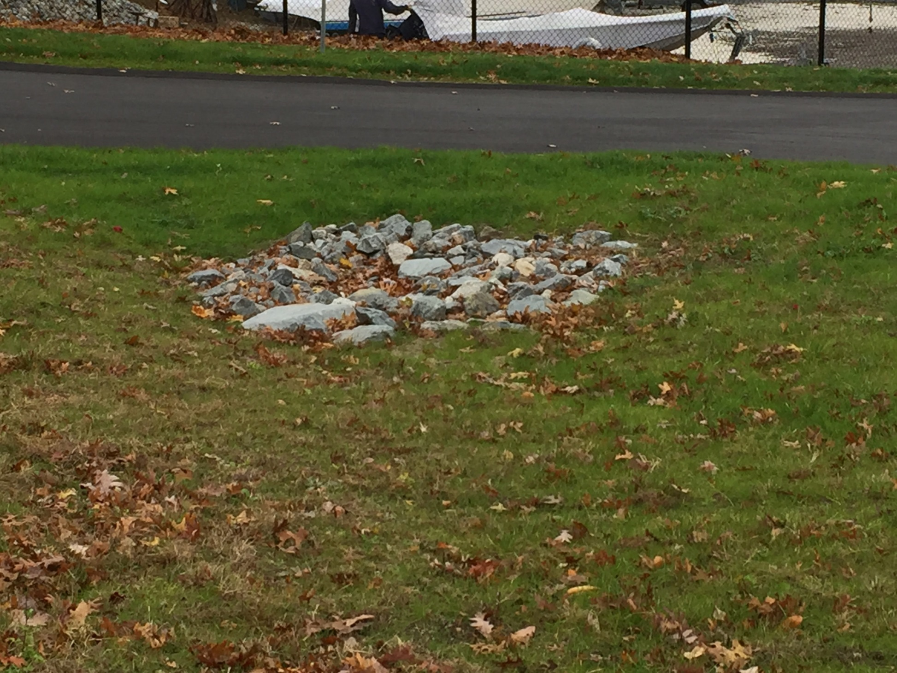

Slide 8
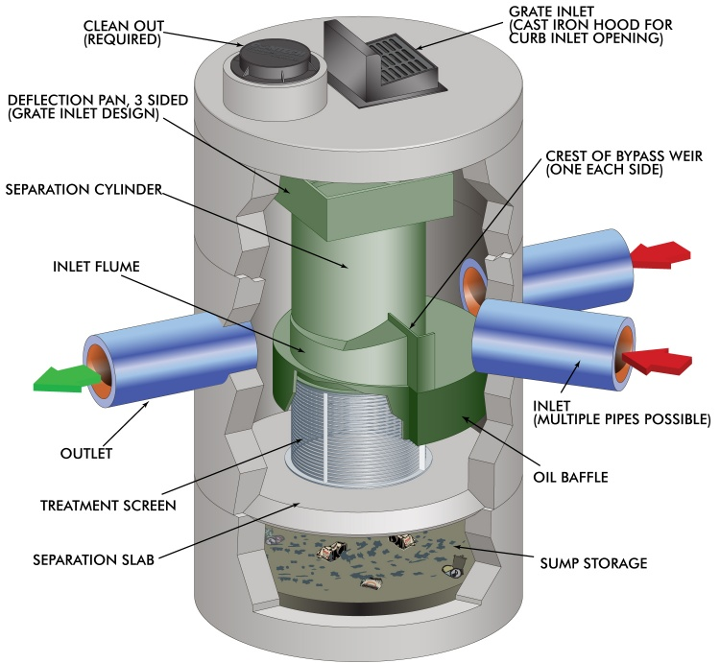

Slide 9
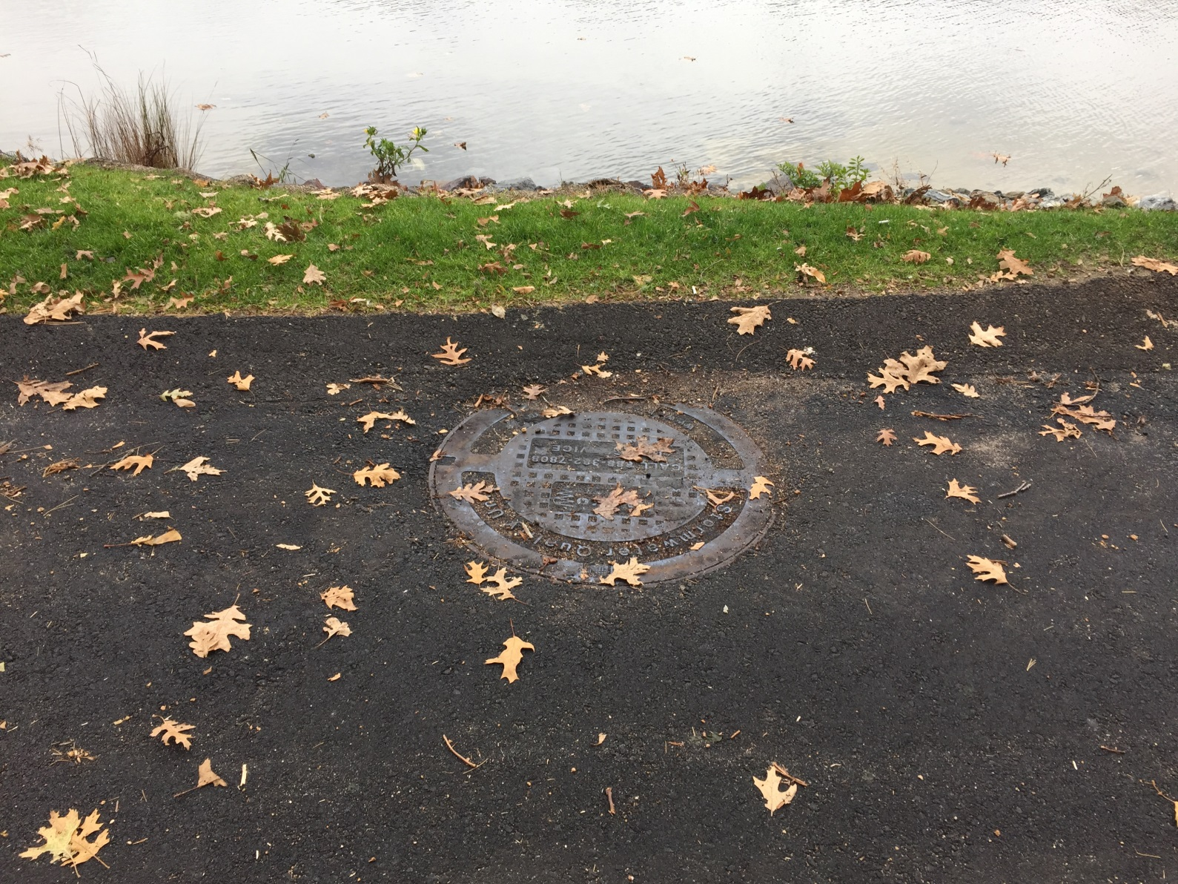

Slide 10
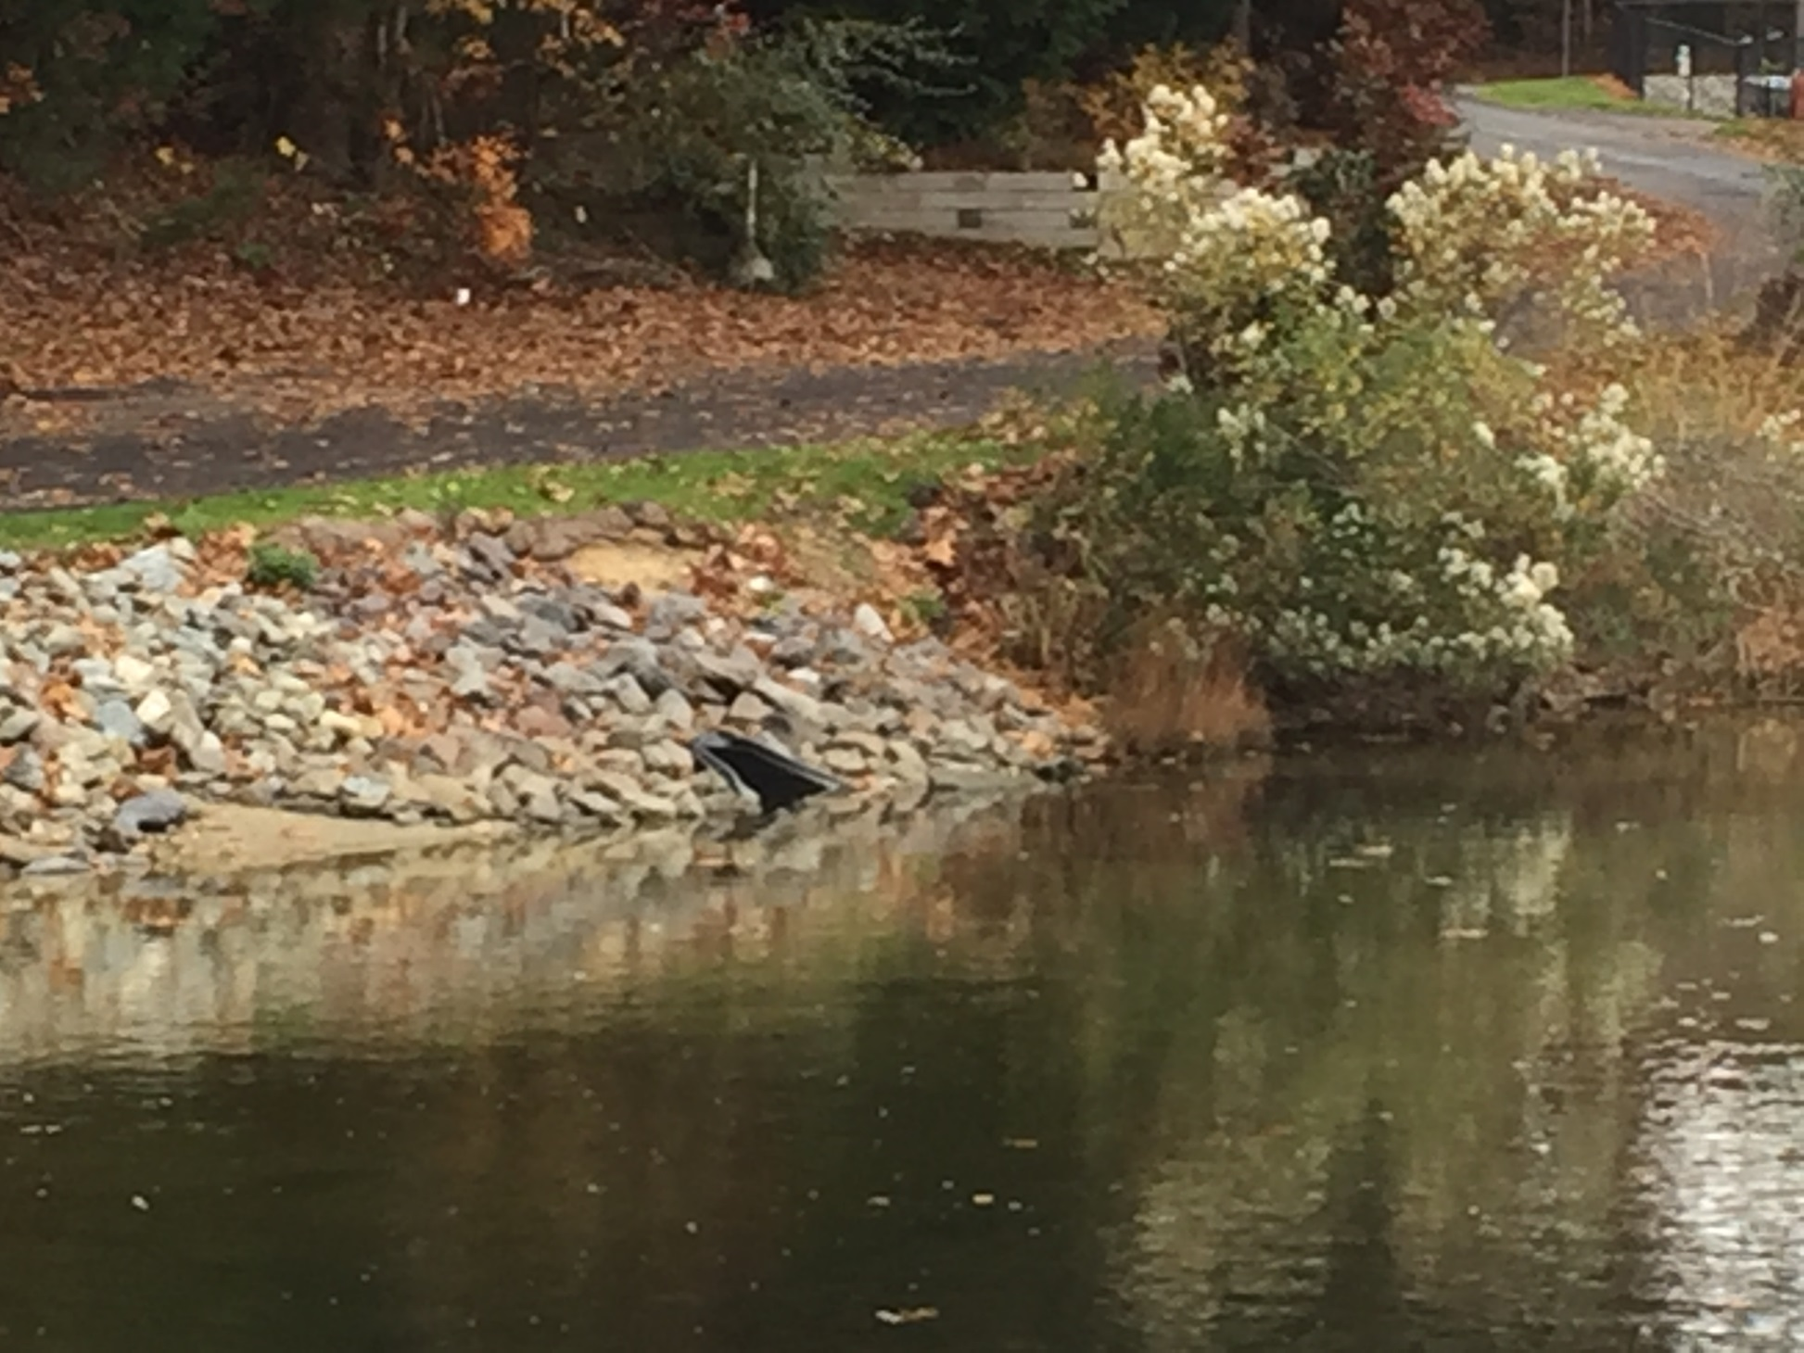

Slide 11
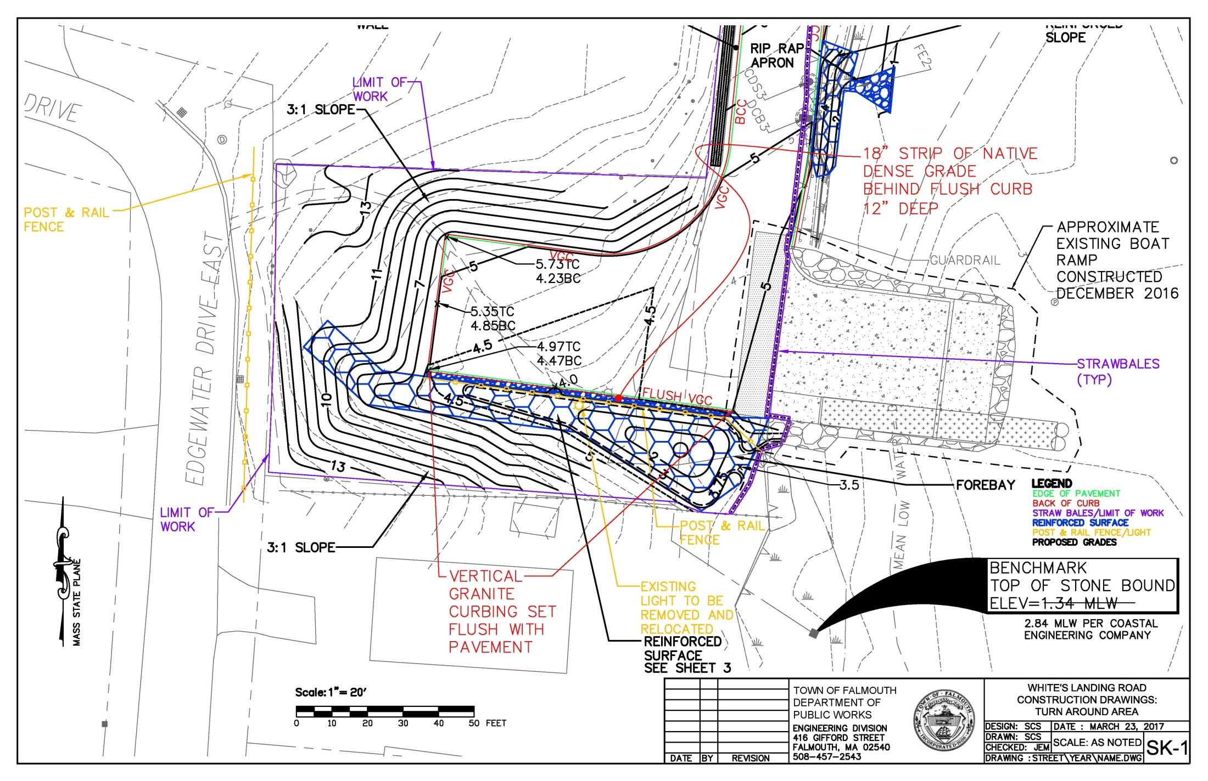

Slide 12
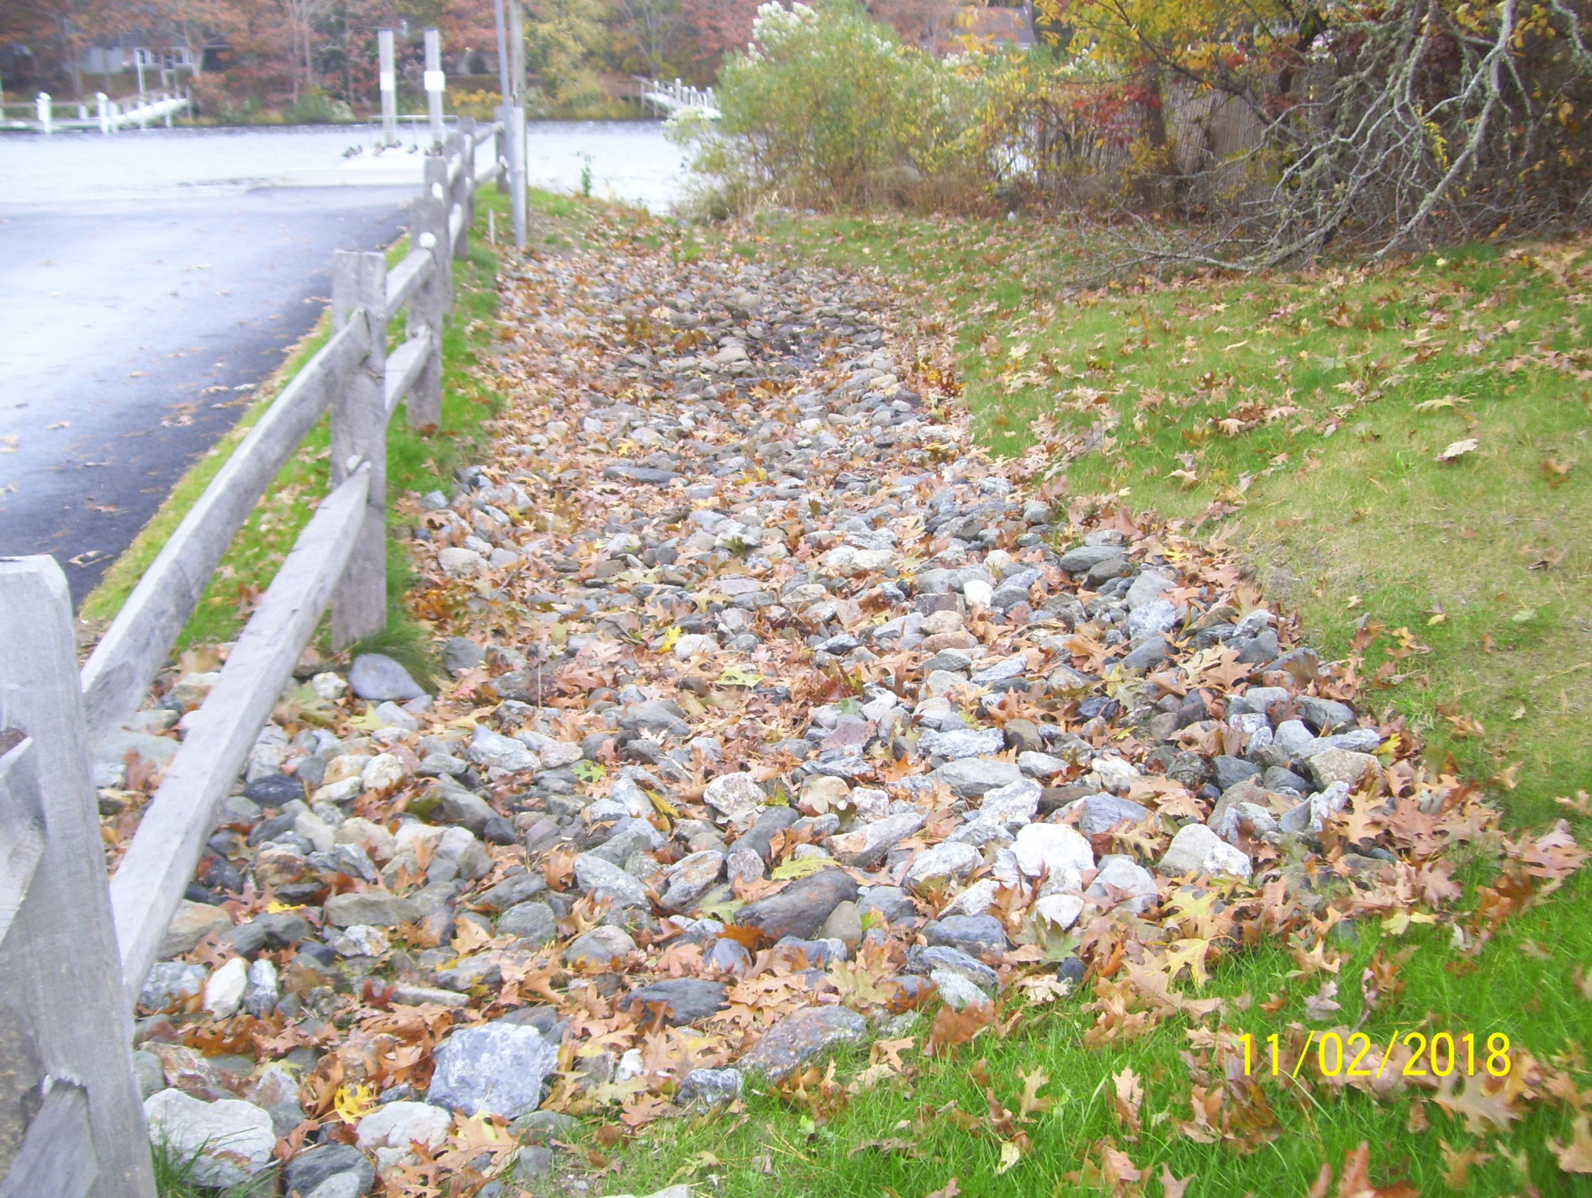

Slide 13
